Slide 1
EFFECT OF COVID-19 ON THE UK ECONOMY
COMPARED TO THAT OF FRANCE.

Slide 2
Introduction
UK economy experienced subsequent falls during the quarters after the outbreak of Convid-19 in the UK and continue to feel the effect and has not fully recovered.
Using data from WHO, Office for National Statistics, Statista and considering factors like GDP ,inflation ,stock price we analyse this effect by means of machine learning,EDA and interpreting the results using Agile to guide the process so we can answer the following questions.

Slide 3
Research questions
What are the economic costs of the pandemic on the UK economy compared to France?
Did the British Government introduce appropriate policies during the pandemic and lockdown?

Slide 4
Literature Review Studies on the Effects of COVID-19 on the UK Economy
(Nasir et al., 2020) used a random forest classifier to predict the effects of the pandemic on UK SMEs, identifying retails and hospitality as the most vulnerable.
(Wang et al., 2021) used SVM classification to analyze the impact of the pandemic on the UK housing market showing decline transaction volumes in some areas.
(Zhang et al., 2022) used a neural network classifier to analyze the impact of the pandemic on consumer behaviour in the UK, revealing significant changes in the spending patterns and the shift towards online banking.
Using a computable general equilibrium model, Keogh-Brown et al. (2019) analyze the economic effects of the Covid-19 epidemic on the United Kingdom and simulate three different scenarios

Slide 5
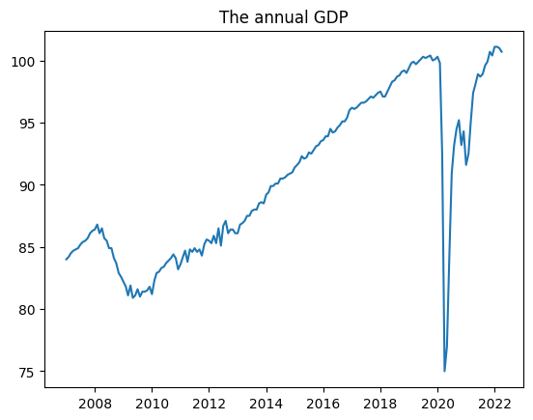
EDA
Figure 1: Annual GDP of the UK economy

Slide 6
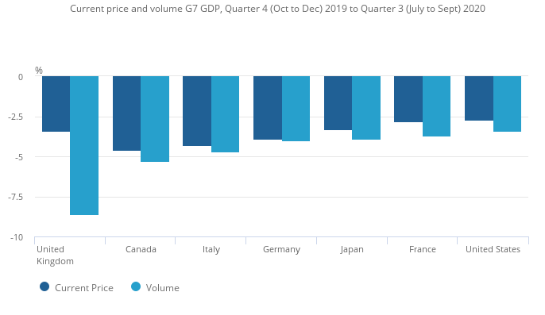
EDA
Source: (Gooding, 2021;
Leaker, 2021; McAuley, 2021)
Figure 2:The GDP of UK
compared to similar
G7 economies like France

Slide 7
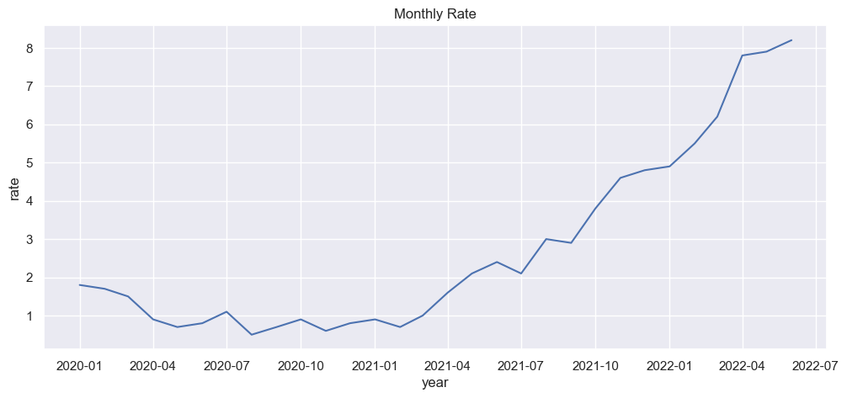
EDA
Annual Inflation (Monthly)
of the UK Economy

Slide 8
COMPARISON OF THE EFFECT OF COVID 19 OF THE UK AND FRANCE USING THE COVID 19 DATA AND THE STOCK DATA
After normalization of the dataset and creating a weighted dictionary for comparison
creating a formula for it that will show the comparison of how the cases, death and stock affect each other, if the comparison is true (1) that means France was affected and if the comparison is false (0) then the UK was affected more.
From the formula to quantify the relative impact of cases, deaths, and stocks on each country; a positive result indicates that France was hit harder than the United Kingdom, while a negative result indicates that Britain suffered more. The results suggest that France was hit harder than the UK (35%).

Slide 9
EMPLOYING 4 MACHINE LEARNING TECHNIQUES TO PREDICT THE COMPARISON OUTCOMES OF UK AND FRANCE
Support Vector-86%
Decision Tree-77%
Random Forest-86%
Logistic Regression -74%
Support vector machine and random forest have the same accuracy, which means we can deploy any of the highest models depending on the preferences.

Slide 10
PREDITION OF NEW CASES OF COVID 19 IN UNITED KINGDOM
With the help of the previously compiled WHO Covid-19 dataset we’ll be able to predict new cases of covid 19 and this can also be deployed for any other terminal diseases that’s unforeseen.
During this phase, we used the Random Forest Regressor and the Light Gradient Boosting Machine Regressor. Model selection for these methods also made use of Randomized Search Cross Validation.
RMS
Random Forest Regressor-7649.47
LGBM Regressor-6542.68
LGBM regressor is chosen is it has a less RMS

Slide 11
Research questions answers
Sickness-related job absences are more important than deaths in causing a decline in GDP as well as businesses closing, and employees being laid off are both possible outcomes of a decline GDP.
Job Retention Scheme have been successful in preventing the loss of employment, providing a means of support and employment stability.

Slide 12
Conclusion
During the covid-19 period, GDP suffered the most than the other economics indicators. Inflation fell too making deflation possible.
We have developed a formula to quantify the relative impact of cases, deaths, and stocks on each country.
For prediction of future cases of Covid-19,the LGBM performed better than the random forest regressor.

Slide 13
Lessons learnt and future Studies
An avenue to continue to further sharpen my research and writing skills
Data manipulation skills and viewing datasets from different perspectives
Due to time and data constraints I could not compare UK economy to similar economies like US, China, Japan and Germany.

Slide 14
THANK YOU

